Slide 1
SPEED DATING
By UniCupid

Slide 2
8067
Stagecast code

Slide 3
WHOA!
Is it hard to find someone to talk to during an event or party?
How do you find someone with common interest in a playful way?

Slide 4
No worries!
This game will provide the first icebreaker by matching you with another person with similar interests!

Slide 5
1
2
3
4
HOW IT WORKS
Answer a couple of
QUESTIONS
The app will FIND A PARTNER for you
The app tells you which MATCHING RESULTS you got
The mini-game matches you to a partner with common INTERESTS

Slide 6
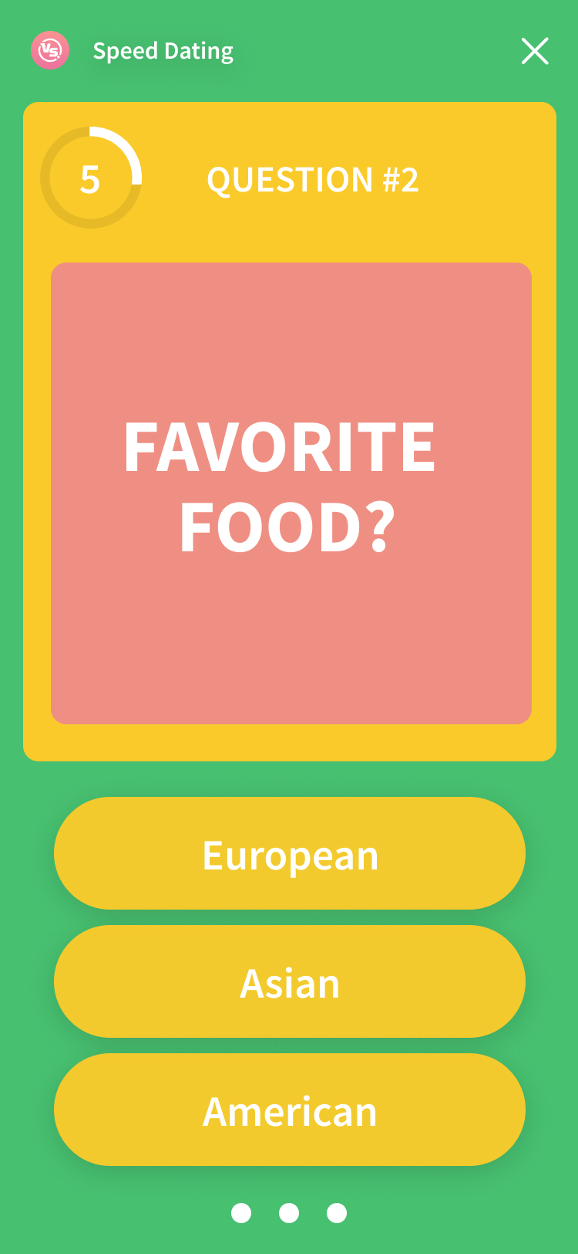
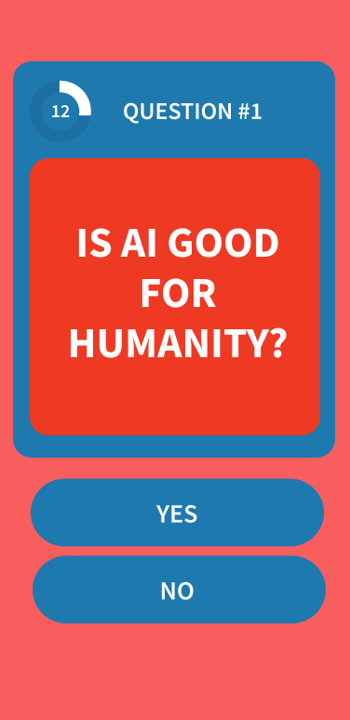
1
ANSWER THE QUIZ

Slide 7
What happens next?

Slide 8
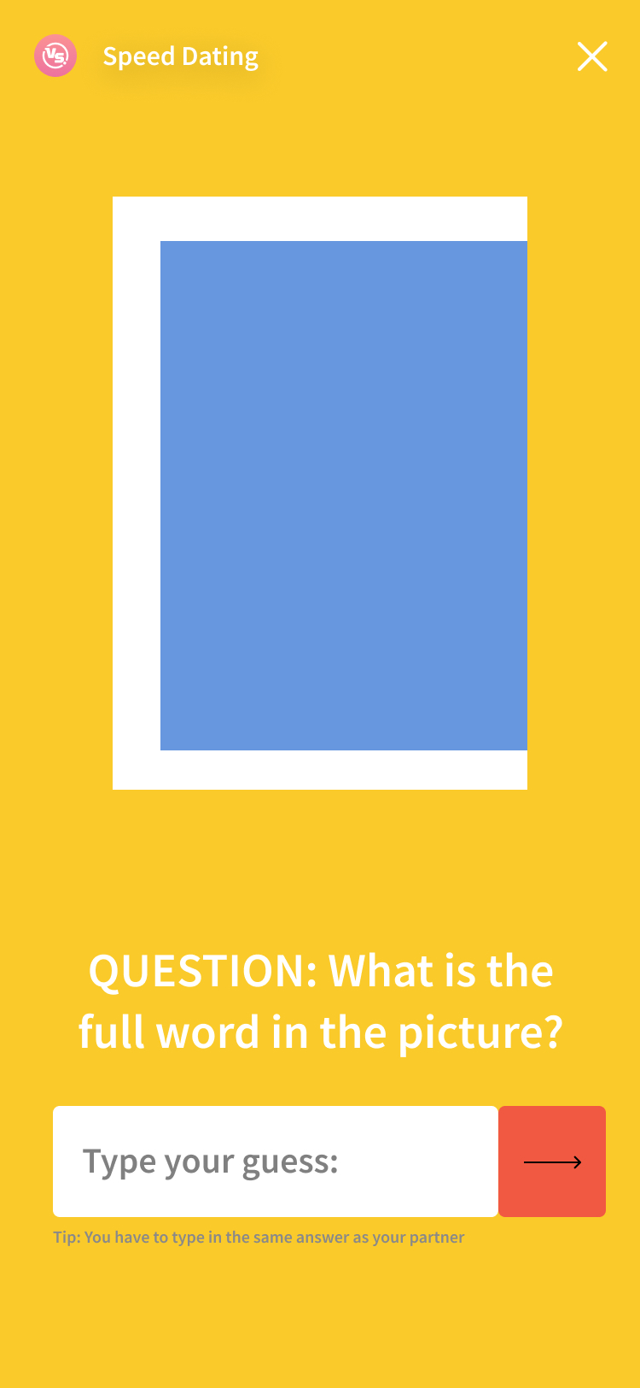
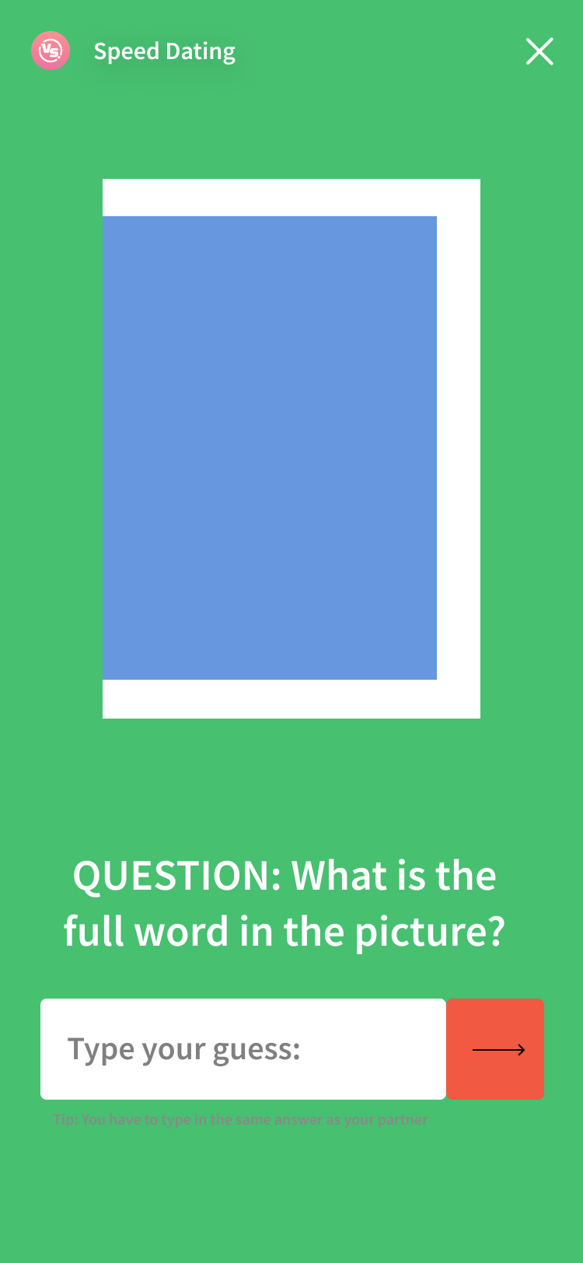
2
FIND YOUR PARTNER WITH A MINI-GAME
Match the right picture with your partner!

Slide 9
MEANINGFUL RESULTS
The app shows which interest were in common and which wasn’t so similar,
and suggests icebreaker topics. This way you can find people who like similar things.

Slide 10
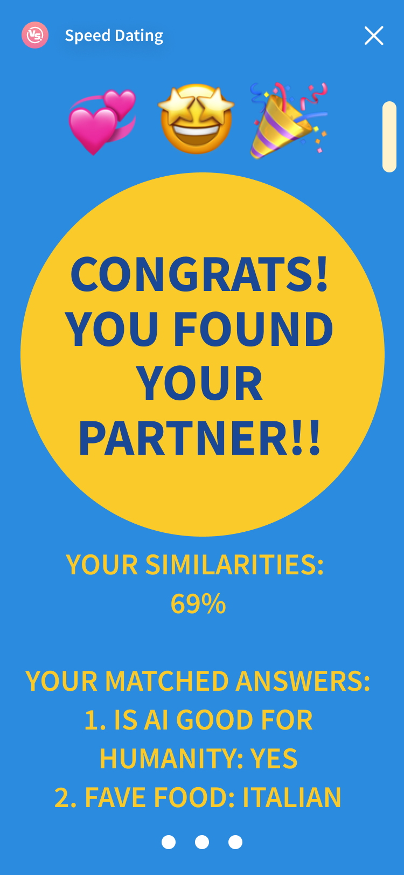
SEE WHAT YOU AGREE AND DISAGREE ON
And discuss why….

Slide 11
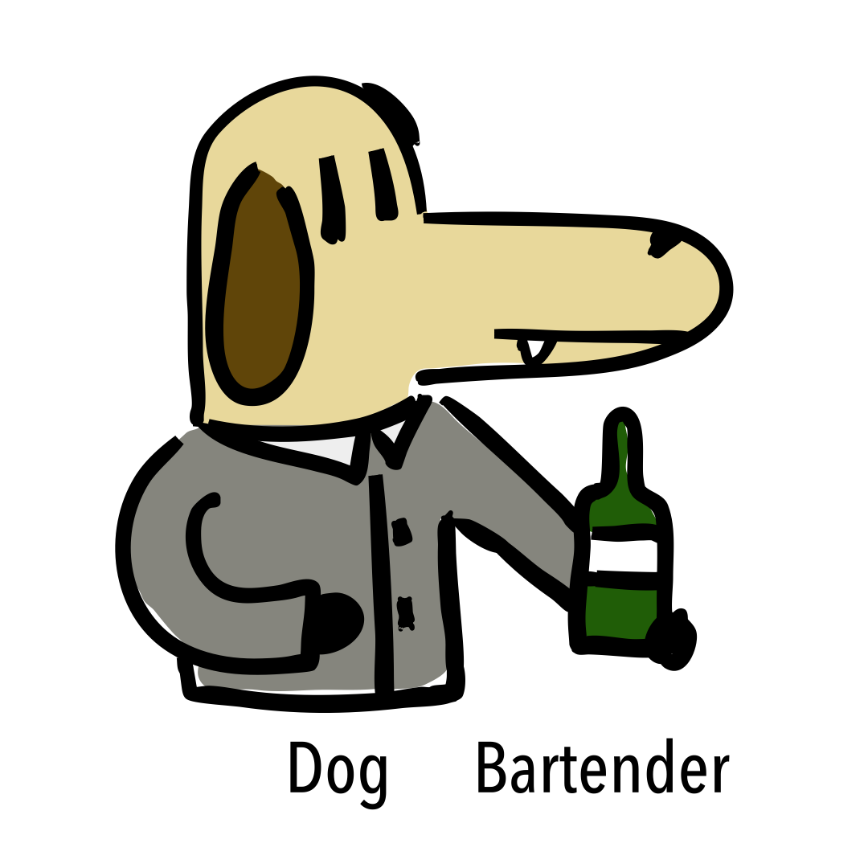
IN THE FUTURE
Smoother
Experience
Matched
Picture
Customizable
Quizes
&
Match by
Opposites or Similarities
Made for
every kind of
PARTY &
EVENT

Slide 12
THANKS!

Slide 13

